Slide 1
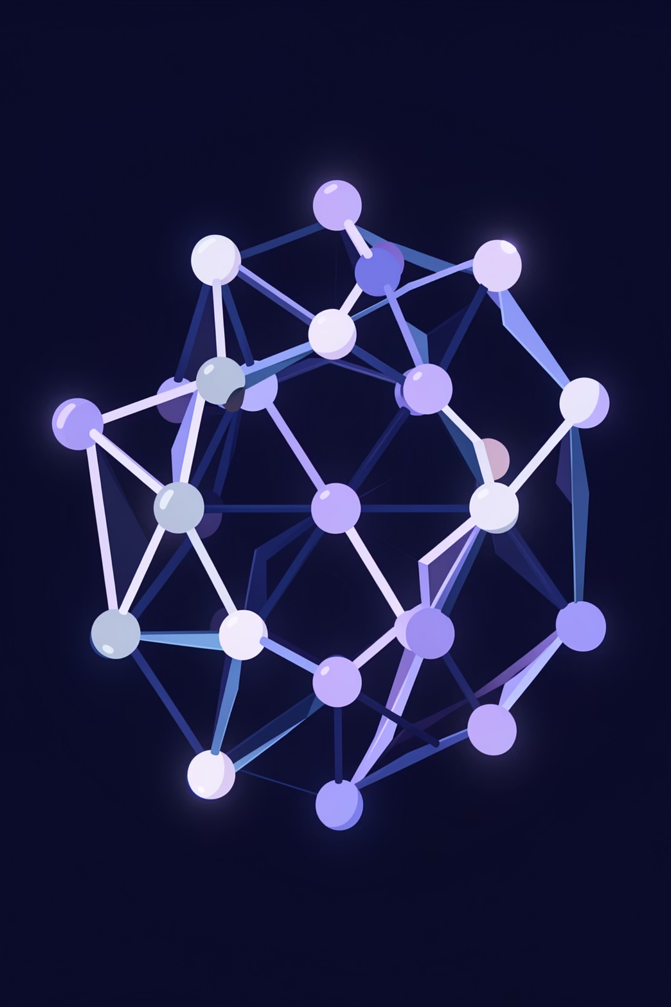
Crystal Diffusion VAE
Generative AI for Inverse Materials Design
DEEP LEARNING
MATERIALS SCIENCE
GRAPH NEURAL NETWORKS

Slide 2

Abstract
CDVAE encodes crystal structures into a continuous latent space via periodic graph neural networks, then generates novel materials through annealed Langevin diffusion.
Encode
Predict
Generate
Crystal → Latent vector
Latent → Properties
Latent → New crystal

Slide 3
The Problem — And Our Solution
Existing Model Failures
v4 Enhancements
Lattice Collapse
Log-Space Training
Boundary Clamping
Zero-volume unit cells
Scale-invariant loss
Hard 2.5–25 Å limits
Scale Bias
Overlap Penalties
Density Regularizer
Errors unequal across scales
Repulsion loss enforces physics
Volume–atom consistency
Disconnected Geometry
Atoms outside containers

Slide 4
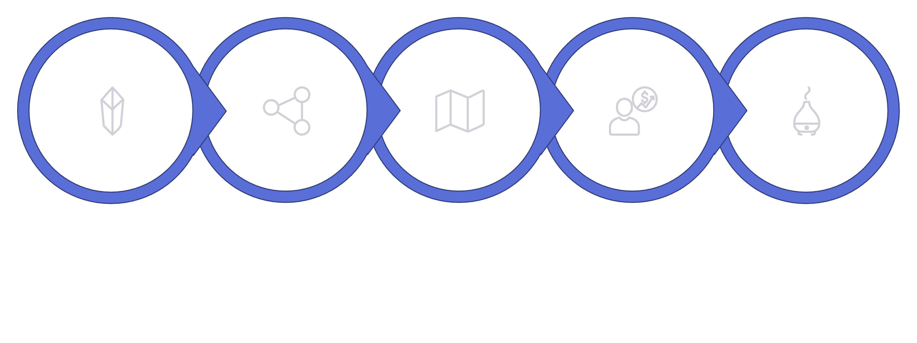

The V-Shaped Workflow
Property Predictor
Decoder + Diffusion
Input Crystal
Encoder
Latent Space
Complex crystal data is compressed to a latent point, then reconstructed into a physically valid structure via diffusion.

Slide 5
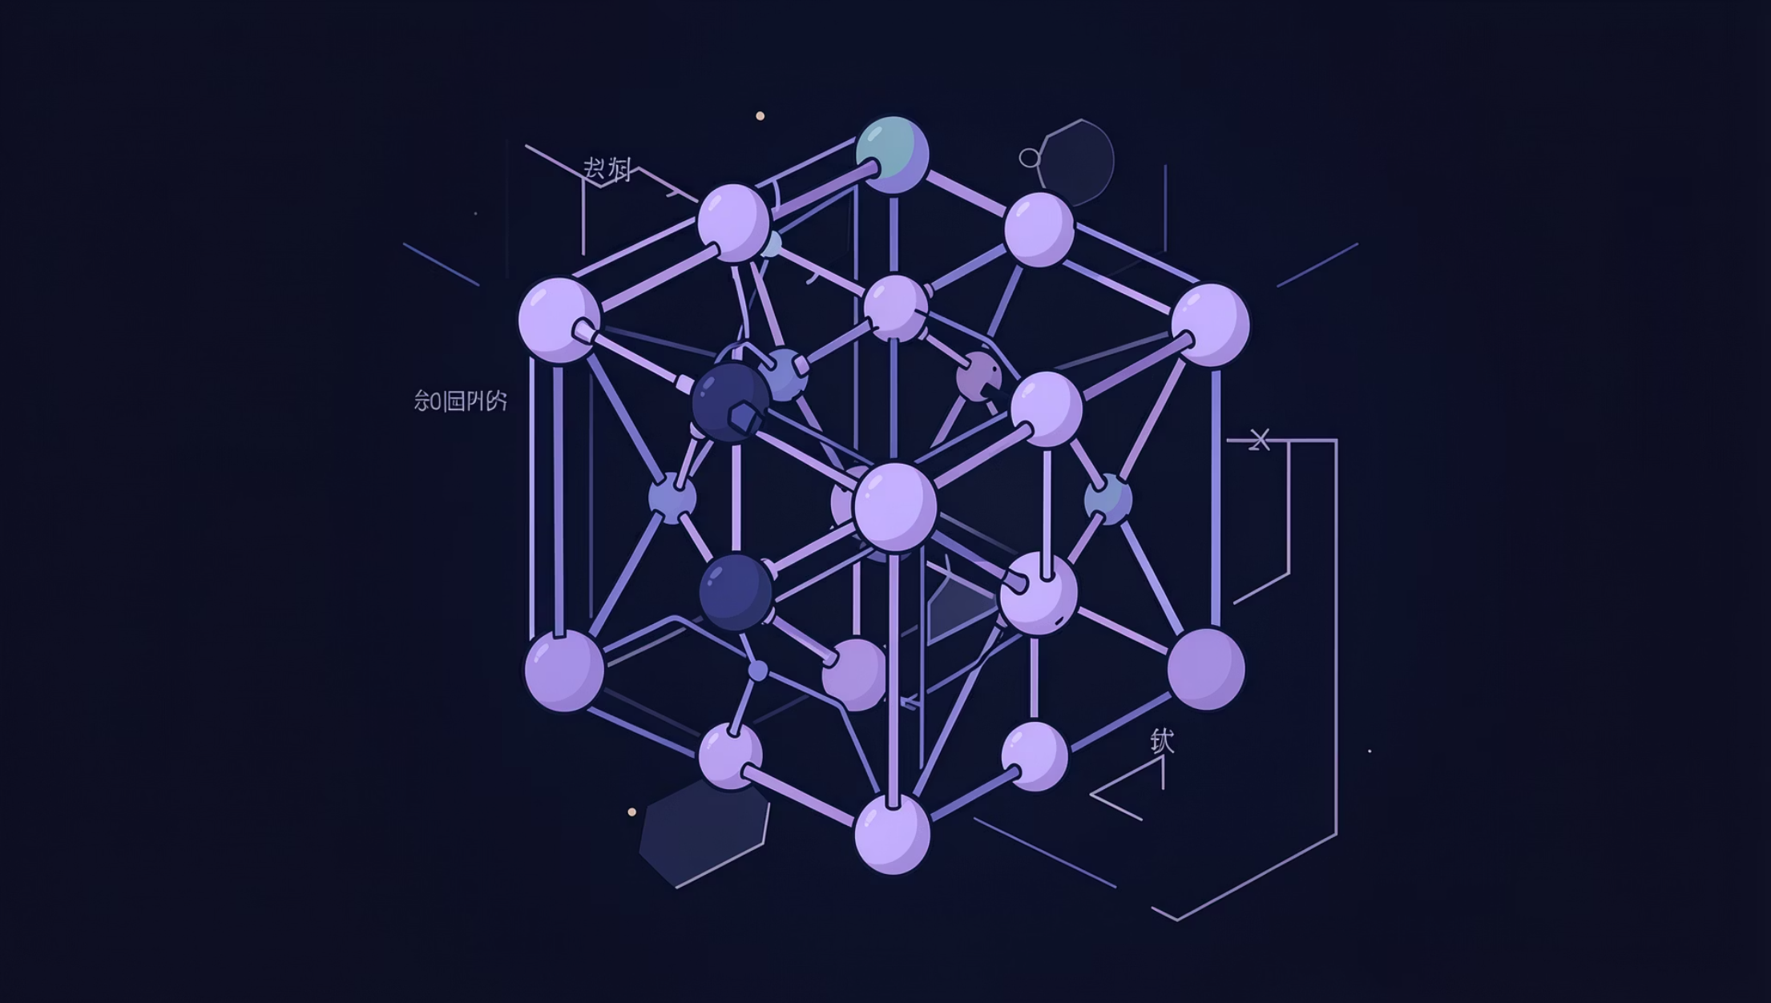
Module 1 — The Encoder
01
Input Graph
Atoms as nodes, bonds as edges
02
Periodic GNN
Cross-boundary distances via PBC
03
Feature Extraction
Atomic numbers → high-dim vectors
04
Bottleneck
Compress to μ and σ for latent sampling

Slide 6
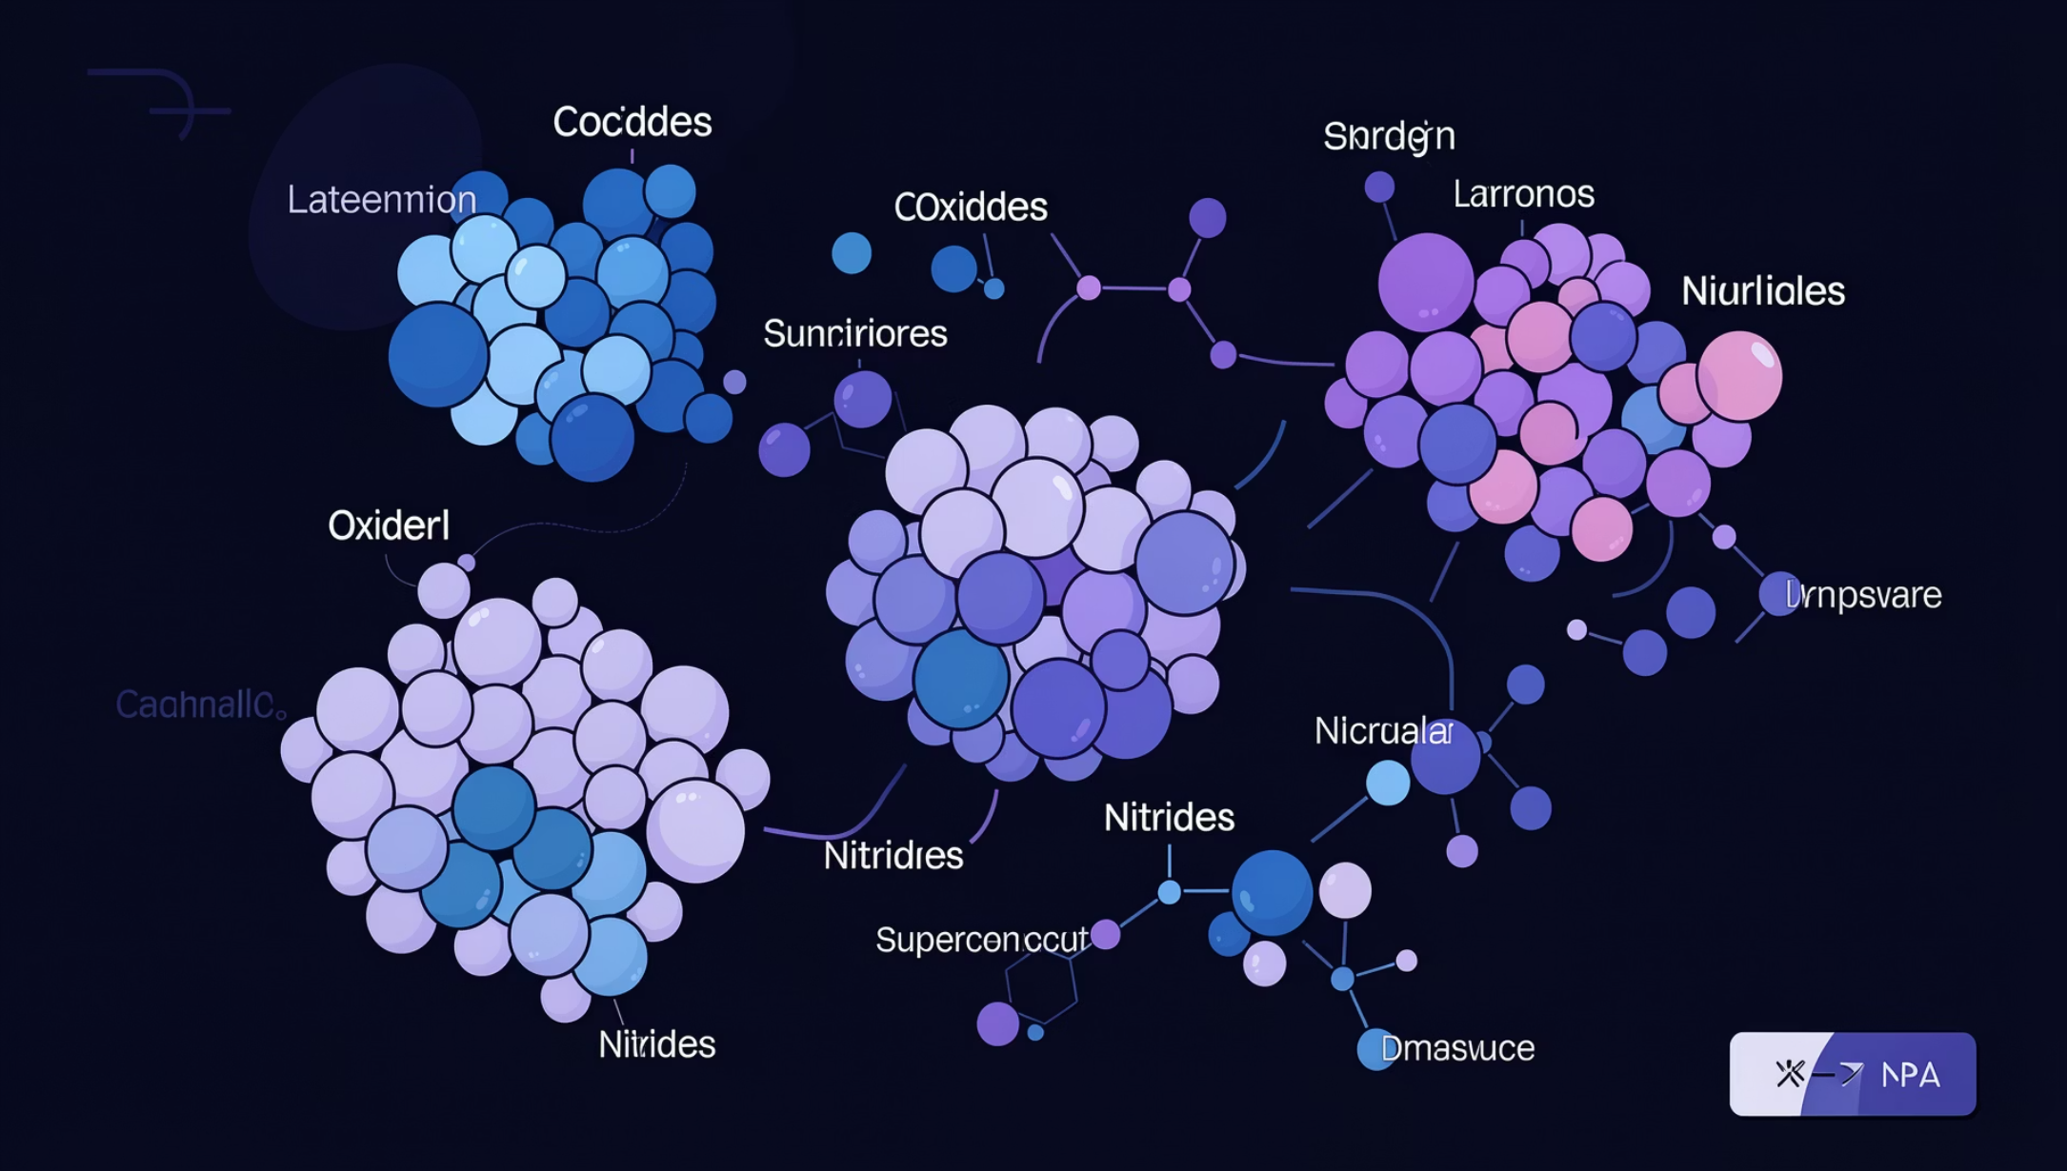
Module 2 — The Latent Space
A Continuous Chemical Map
Every point encodes a valid material. Smooth interpolation transitions between phases.
Continuous
Structured
Generative
No gaps — walk between phases
Clusters: Oxides, Nitrides, Superconductors
Sample anywhere → new material

Slide 7

Module 3 — Property Predictor
The Oracle
Predicts the material "blueprint" before decoding.
Composition
Atom count & types
Lattice Size
Unit cell dimensions
Stability
Energy above hull, band gap

Slide 8
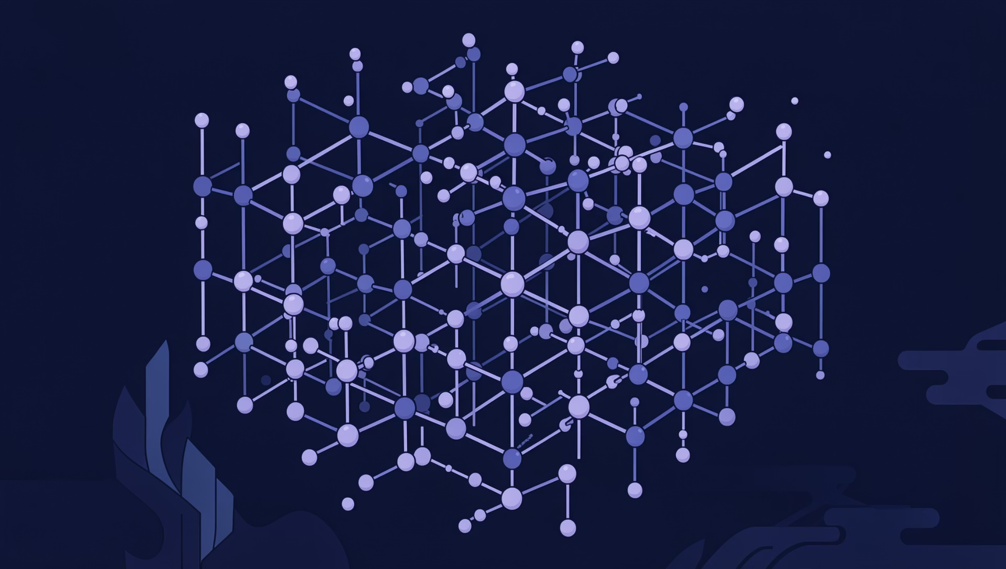




Module 4 — Decoder & Diffusion
Iterative Refinement from Chaos
Atomic Chaos
Random positions
Score Network
Gradient forces guide atoms
Langevin Dynamics
Gradual cooling, identity refinement
Valid Crystal
Stable, physically correct output

Slide 9
Libraries & Technical Stack
Core tools, workflows, libraries, and deployment infrastructure.
Main Framework & Core
Data & Numerical Computing
PyTorch — tensor math and neural networks
torch.nn.functional — activations and losses
NumPy — array math and vector ops
Pandas — tables and CSV data
scikit-learn — preprocessing and splits
Visualization
Training & Acceleration
Plotly— plots and analysis
PyTorch Lightning — training loops and GPU support
Domain Libraries
Utilities
Torch Geometric — graph neural networks
Pymatgen — CIF parsing and materials logic
ASE — atomic structure handling
tqdm — progress tracking
API & Web
Training Data
FastAPI — API endpoints
Uvicorn — app server
Kaggle — dataset source

Slide 10
Inputs, Outputs & Impact
Workflow from dataset preparation to latent representation and evaluation.
Dataset
Input
MP20 dataset — 45,000 stable inorganic crystals from Materials Project, filtered to ≤20 atoms per unit cell
CIF files processed via Pymatgen to extract 3D atomic coordinates and lattice vectors, transformed into a periodic graph (atoms as nodes, spatial proximities as edges)
Output
Metrics & Losses
Compressed latent vector (z) representing chemical and geometric identity of the material
Reconstruction Losses: Cross-Entropy for atom types, MSE for lattice/positions
KL Divergence: regularize latent space
Overlap Penalty: prevent atoms too close
Validity metrics: check if structures are physically possible
Property Prediction Accuracy: energy and band gap

